Slide 1
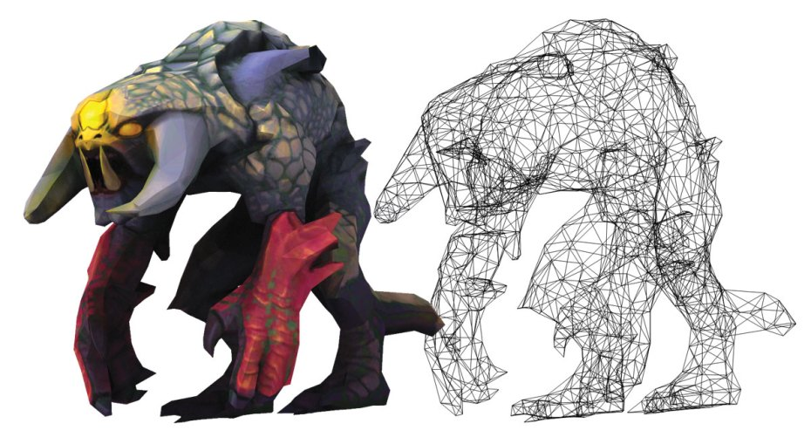
Modeling
CSCI 440 Computer Graphics
based on Chapter 9 of
Interactive Computer Graphics by Edward Angel
http://i0.wp.com/makezineblog.files.wordpress.com/2014/03/m83-video-game-plushies-3d-model.jpg

Slide 2
The Problem
Our method of hand coding points and calling DrawArrays() over-and-over-and-over is not scalable or maintainable.
How do we manage large numbers of points and relationships between scene components?

Slide 3
The Modeling Problem

Slide 4
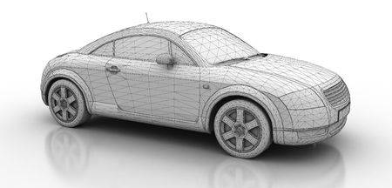
Lots of Data Points
How could we handle these data points?
What information needs to be stored in these data files?
coordinates
organization of points: triangles, triangle fan, lines, …
normal
texture coordinates or color
123rf.com

Slide 5
Processing Lot of Data Points
How would we process that file?
send coordinates, normals, and texture coordinates to the GPU
create a data structure that indicates how the points are organized.
repeatedly draw that list
Type | # of Points | Color
Fan | 6 | blue
Triangles | 40 | texture 1
Fan | 30 | texture 2
Fan | 6 | texture 1

Slide 6
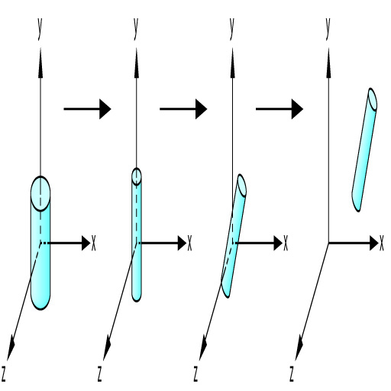
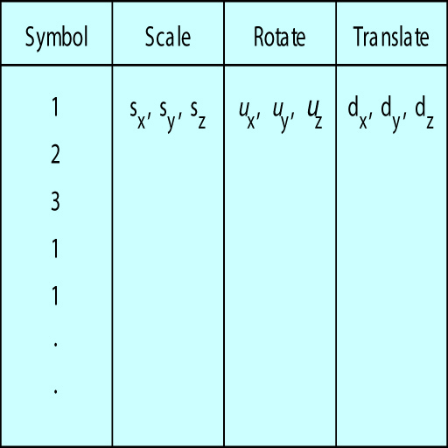
Data Structure for Simple Scenes
Angel figures 9.2 and 9.3

Slide 7

Example
Remember Dannelly's small school of fish?
How would we manage dozens of fish, composed of multiple types (textures), all moving independently?

Slide 8
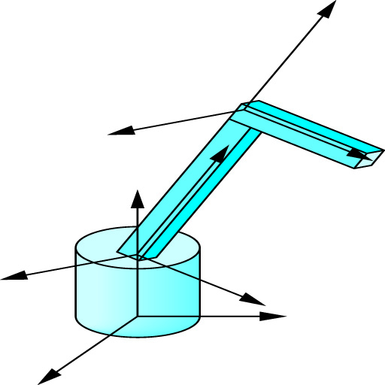
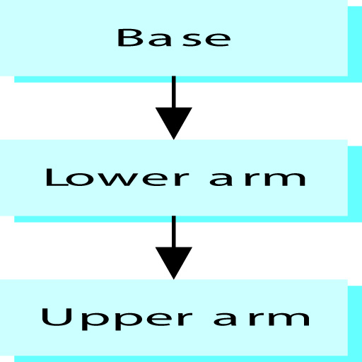
Complex Objects

Slide 9
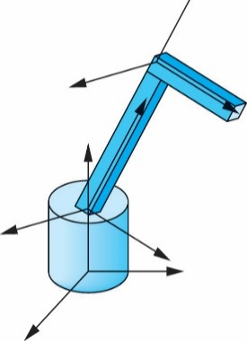
function render()
{
gl.clear(…);
modelMatrix = rotate (angle[base], 0,1,0 );
drawBase();
modelMatrix = mult (modelMatrix,
translate ( 0, baseHeight, 0));
modelMatrix = mult (modelMatrix,
rotate ( angle[lowerArm], 0,0,1 );
drawLowerArm();
modelMatrix = mult (modelMatrix,
translate ( 0, lowerArmLength, 0));
modelMatrix = mult (modelMatrix,
rotate ( angle[upperArm], 0,0,1 );
drawUpperArm();

Slide 10
Animation
How could we animate that arm?
Key Frame : list the transformations for key times.
a really long list of rotations with times indexes
In Betweening : List some transformation-times, have the GPU fill in remaining frames
curves help make smooth movements
Angel textbook section 9.6

Slide 11

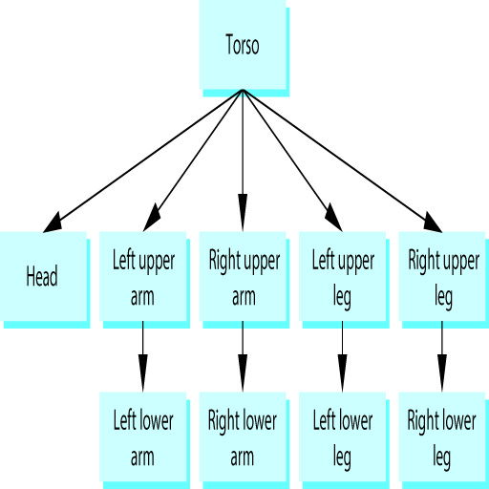
Really Complex Objects
Angel figures 9.12 and 9.13

Slide 12
Tree Traversal
Traversal Order?
pre-order
in-order
post-order
Coding Method?
manual traversal
recursive traversal
Node Content?

Slide 13
Object Oriented Modelling
leftUpperLeg = new Cube();
leftUpperLeg.width = 10;
leftUpperLeg.height = 50;
leftUpperLeg.color = red;
leftUpperLeg.shininess = 100;
leftUpperLeg.diffuse = 0.5;
torso.add (leftUpperLeg, location);

Slide 14
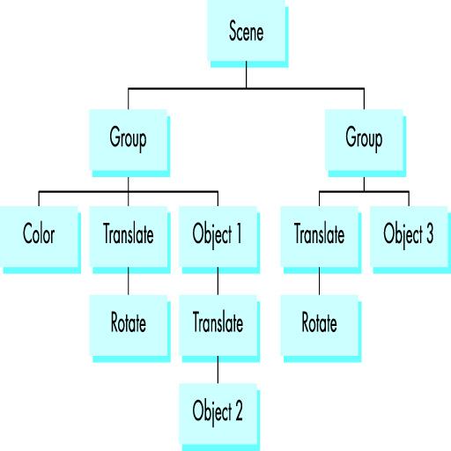
Scene Modeling
Angel figure 9.18

Slide 15
Scene Implementation
Store the scene as a database.
Renderer could be WebGL or something else.
Working at a higher level means less control of CPU and GPU, so poor performance.

Slide 16
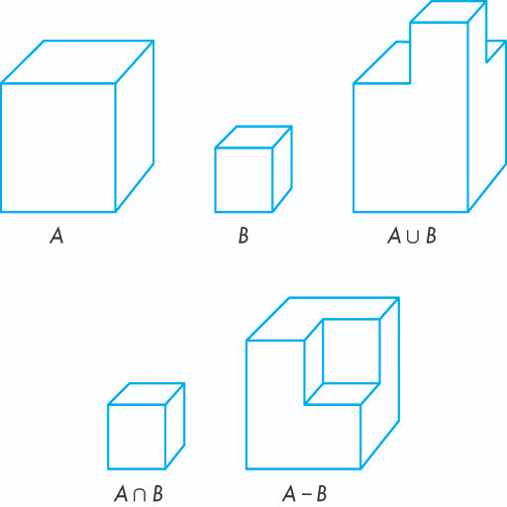
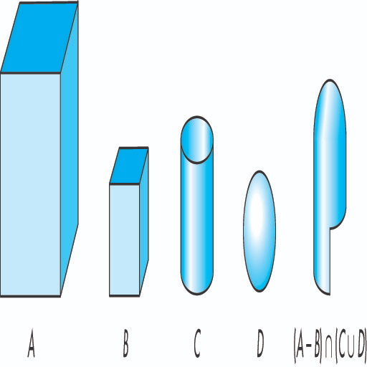
Constructive Solid Geometry
Angel textbook figures 9.22 and 9.23

Slide 17
Moral of Today's Story
To model a complex scene you will need to either build a complex data management and rendering system, or learn a complex API that sits on top of WebGL.

